Slide 1

Chapter 2: Classifying biodiversity

Slide 2
Why do we classify organisms?
Why do we classify organisms?
Classification of organisms is done for several reasons.
The diversity of life on Earth is vast, so classifying organisms is a way of organising information. It allows for patterns and trends to be observed and relationships between organisms better understood.
2. It allows biologists to analyse information about organisms.
3. It allows biologists to communicate with one another.
Notes:
Classification systems are a way of sorting, so that similar or related organisms are grouped together.

Slide 3
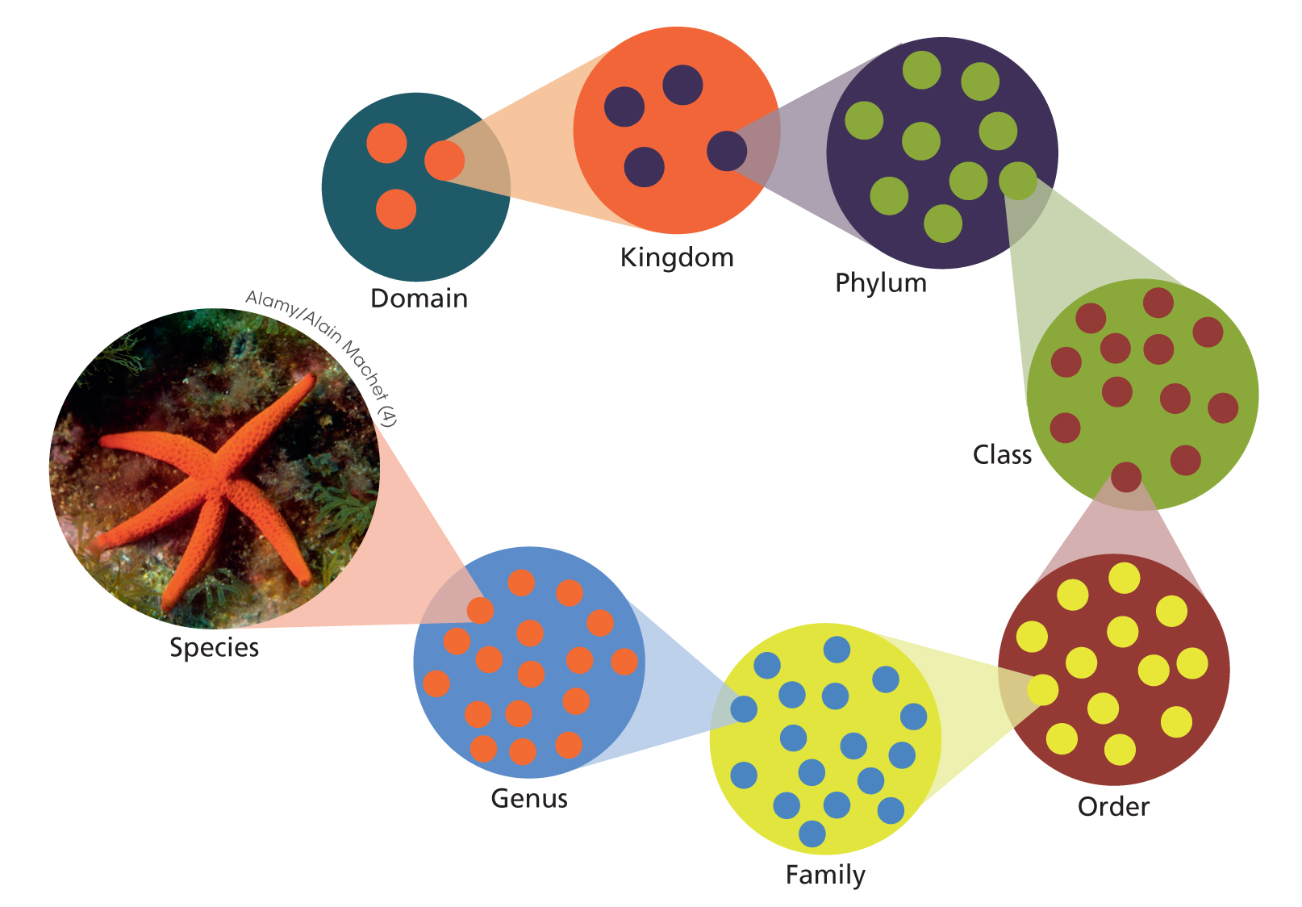
Levels of classification
Figure 2.2
The hierarchy of the taxa.
Each taxonomic level can be divided into
multiple groups in the level below.
Notes:
Organisms are classified into a hierarchy of groups called taxa. The names of the major taxa, from largest to smallest, are Domain, Kingdom, Phylum, Class, Order, Family, Genus and Species.

Slide 4
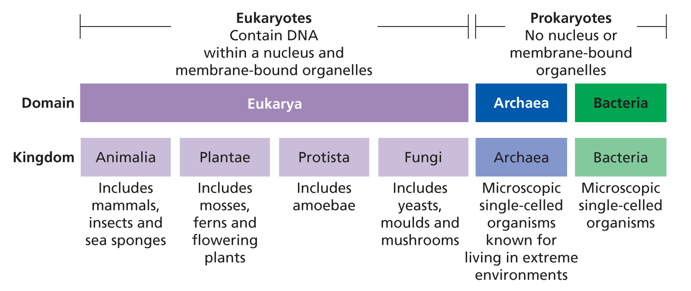
Levels of classification
Figure 2.3 The initial divisions of life: the domains and kingdoms
Notes:
The initial division of life into three domains (Figure 2.3) is based on cellular characteristics. Members of Domain Eukarya (eukaryotes) contain their DNA (deoxyribonucleic acid) within a nucleus and have other membrane-bound compartments (organelles) within their cells. Domains Archaea and Bacteria contain prokaryotes: organisms that lack these features. Prokaryotes are microscopic, single-celled organisms. Despite this superficial similarity, organisms in Domains Archaea and Bacteria have differences in the way DNA is stored and proteins are synthesised which means that they are classified in separate domains. Many of the members of Domain Archaea live in extreme environments (such as areas of high salt or temperature).
There are four kingdoms in domain Eukarya: Animalia, Plantae, Protista and Fungi. Kingdom Animalia contains all of the animals, including some which are single celled. Plants (Kingdom Plantae) have cell walls that contain cellulose and obtain energy from the sun using organelles called chloroplasts. Yeast, mushrooms and moulds all belong to Kingdom Fungi and are characterized by having cell walls made of a specific polysaccharide (chitin). The protists (Kingdom Protista) are a diverse group of organisms, which are mostly single-celled and live in aqueous environments.

Slide 5
Levels of classification
Naming organisms: the binomial system
All organisms have a binomial (scientific) name. Binomial names consist of two parts.
1. Genus
2. Specific to the species
Example: Golden Wattle has the name Acacia (genus) pycnantha (species).
The name for humans, Homo sapiens, comes from the Latin word for ‘wise man’.
Notes:
A binomial name consists of two parts, a generic name and a specific name. The first part (generic name) denotes the genus and is common to all organisms within that genus whereas the second part is unique to a single species. For example, Australia’s floral emblem Golden Wattle has the name Acacia pycnantha. Related species of wattle such as black wattle (Acacia mearnsii) and tan wattle (Acacia decurrens) share the same first part of their name: Acacia. However, the different second part of the name (specific name) indicates that these are different species.
Binomial names are written using Latin grammar, but can come from various sources. Sometimes they describe features of the organism. For example, the binomial name for the short-beaked echidna (Tachyglossus aculeatus) means ‘fast tongued and covered with spines’. In other cases species may be named after a distinguished person, a location or a mythological character. The binomial name for humans, Homo sapiens, comes from the Latin word for ‘wise man’.

Slide 6
Classification is based on the characteristics of organisms
Classification based on characteristics
Classification never stops. Taxonomist opinions differ and some will lump species together and
others will reclassify a species to split it into new species.
At the same time, new species are regularly being discovered.

Slide 7
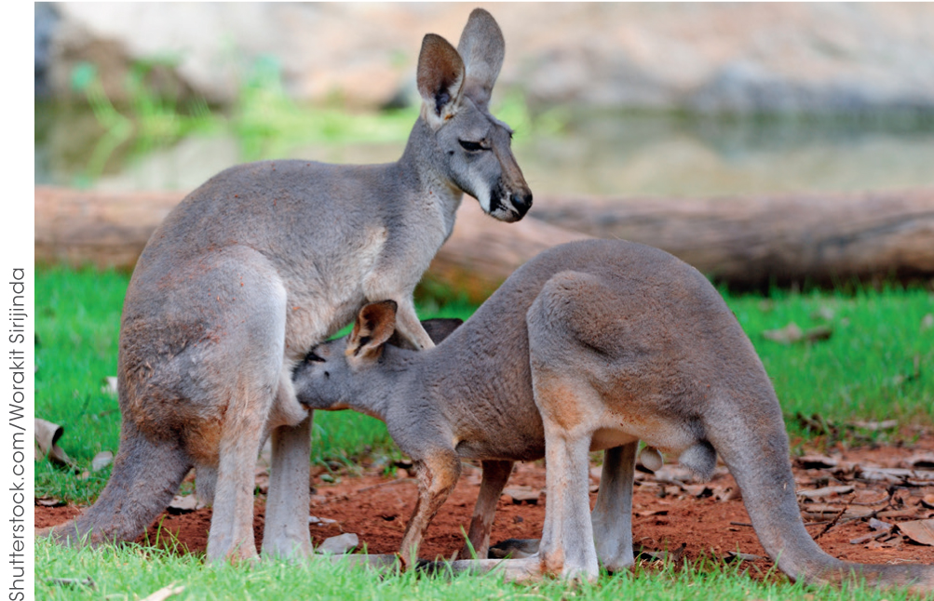
Classification is based on the characteristics of organisms
Classification based on characteristics
Physical characteristics
Reproductive methods
Molecular sequences
Figure 2.5 A kangaroo suckling her joey. Like all other mammals,
kangaroos have fur and produce milk.
Notes:
1. When creating the classification system presented in Systema Naturae, Linnaeus used the physical characteristics of organisms as the basis for his groups. Taxonomists today still use physical characteristics to classify organisms. Almost any aspects of an organism that you can describe could be used in this way.
2. Reproductive methods:
sexual reproduction (with mixing of gametes from two individuals)
asexual reproduction
3. Molecular sequences:
sequences of Deoxyribosenucleic acid (DNA) and proteins
DNA has a sequence of base pairs, whilst protein is a sequence of amino acids

Slide 8
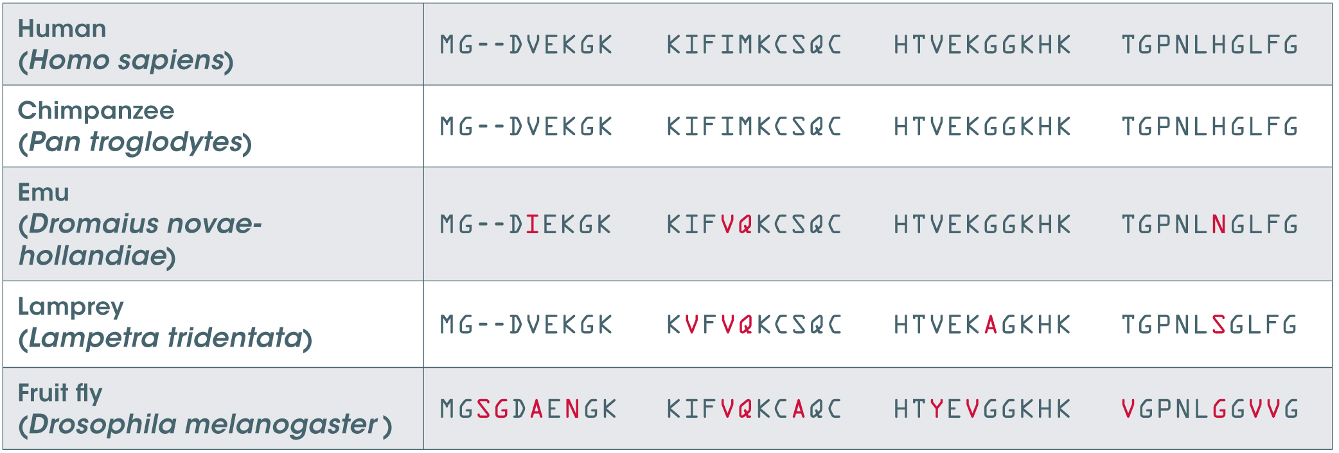
Classification is based on the characteristics of organisms
Classification based on characteristics
Table 2.1 The first 38–40 amino acids in the protein cytochrome c
Notes:
Similar to DNA, information about protein structure can also be used in classification. Proteins are made up of sequences of amino acids and the order of these amino acids can be used to help classify organisms. Table 2.1 shows the sequence of the first 38–40 amino acids in the protein cytochrome c for five different animals. These sequences have been aligned so you can compare them. Each letter stands for a different amino acid. You can see that when an animal has a different amino acid to that in the human sequence, it has been coloured red.
You can see that the amino acid sequences for humans and chimpanzees are identical. This supports the classification of humans and chimpanzees into the same order (Primates). Humans are less similar to emus than they are to chimpanzees. As such, although they are in the same phylum (Chordata), they are in different classes. Emus have four amino acids that differ from humans in this sequence supporting their difference in classification. Fruit flies have 13 amino acids that differ from humans. This supports the fact that unlike all the other animals listed, fruit flies are in Phylum Arthropoda.

Slide 9
Classification is based on the characteristics of organisms
Classification keys
Dichotomous keys are tools used to identify organisms.
They involve choosing between a series of two options until an organism is identified.

Slide 10
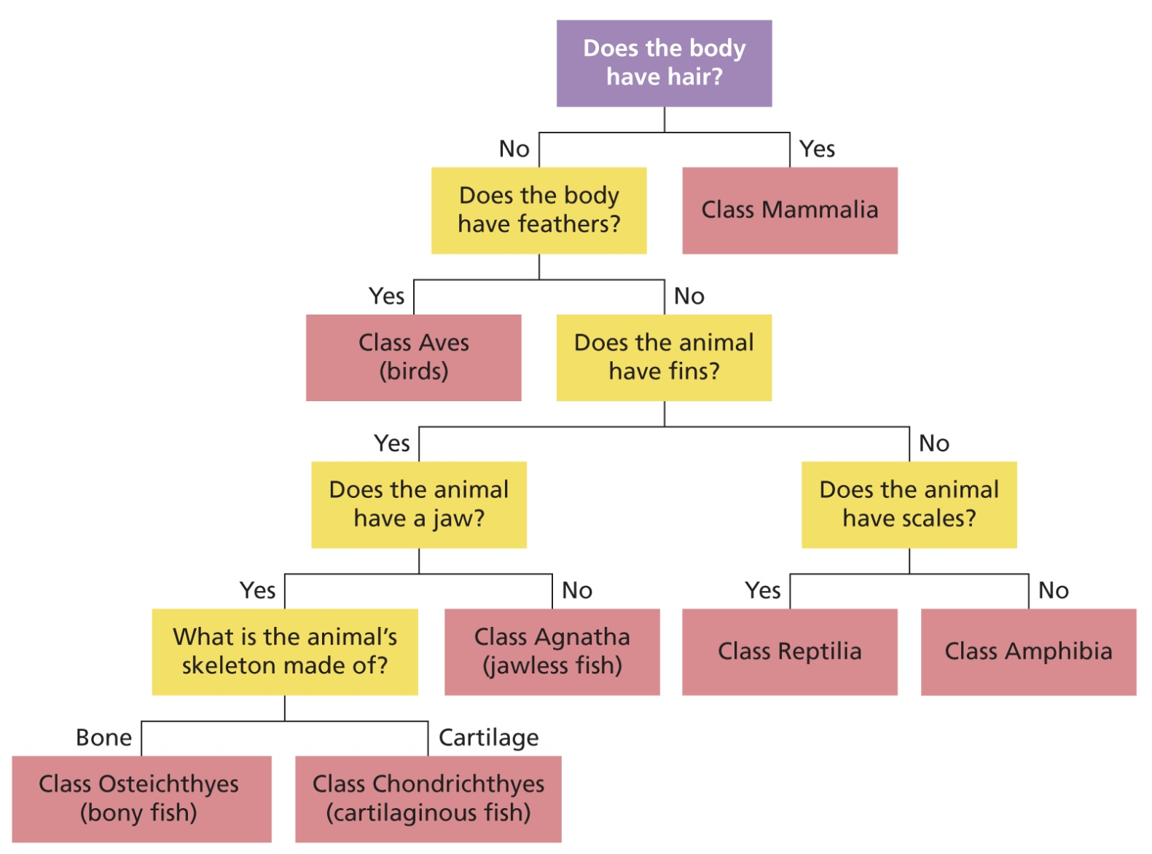
Classification is based on the characteristics of organisms
Classification keys
Figure 2.9
A dichotomous key for
identifying the class of vertebrate animals
Notes:
Imagine if Figure 2.9 had hundreds of branches. Dichotomous keys can be very long so it is not always practical to present them this way. Most keys are presented as a list with the pairs
of choices numbered. A simple dichotomous key for classifying animals into phyla is shown on page 23.

Slide 11
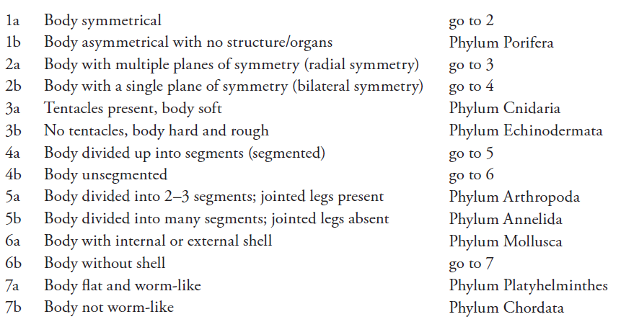
Classification is based on the characteristics of organisms
Classification keys
Often it is more practical to present keys as a list of alternatives.

Slide 12
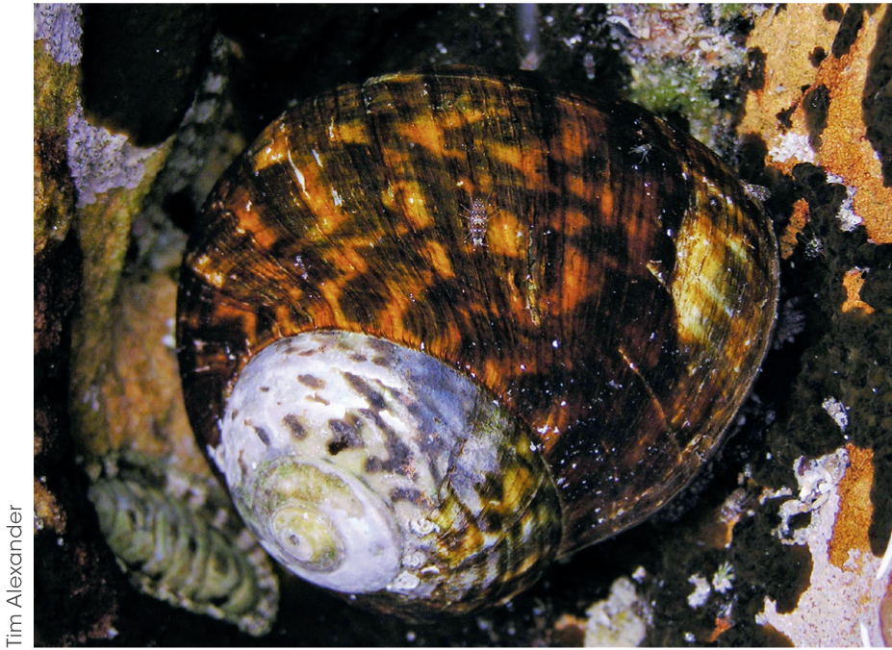
Classification is based on the characteristics of organisms
Learning check
Can you use the key on page 23 to identify the phylum of the snail?
Figure 2.8
This species of sea snail is commonly found in Australian waters.
How would you identify it?
Notes:
We can use this key to identify the phylum of our sea snail (Figure 2.8). The body is symmetrical with a single plane of symmetry so we choose option 1a and then 2b. The body
is unsegmented so we choose option 4b which directs us to pair 6. The sea snail has a shell so we choose option 6a which identifies our sea snail as belonging to Phylum Mollusca. A more
detailed key is needed to identify the further taxa.

Slide 13
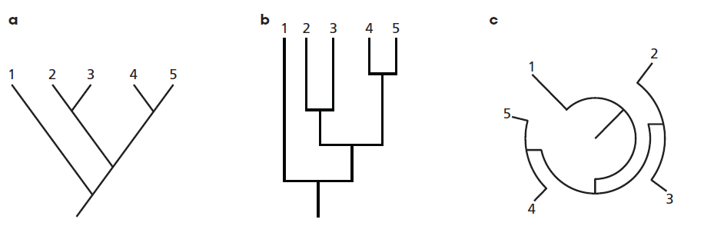
Classification reflects evolutionary relationships
Phylogenic trees
All organisms on Earth are related to one another, meaning that at some point in time they shared a common ancestor.
Phylogenetic trees are diagrams that show these relationships.
If the entire key has two choices at each branching point, the key is dichotomous.
Figure 2.14 Three different ways of drawing phylogenetic trees.
Type c is useful when trees are very large.
Notes:
The more closely related two species are, the more recently they shared a common ancestor.
Higher taxonomic levels branch off from one another earlier than lower levels.
Figure 2.14 shows the different ways phylogenetic trees can be drawn. This tree shows that species 2 and 3 are closely related and that both of these are more closely related to species 4 and 5 than to species 1. You can see that even though each of these shows the same branching pattern, they look quite different.

Slide 14
Classification reflects evolutionary relationships
Cladistics
Organisms are classified into groups that reflect their evolutionary history.
This classification is based on the fact that related organisms share characteristics.
Notes:
Phylogenetic trees made using this technique are known as cladograms. Cladistics relies on several assumptions.
The more closely related two organisms are, the more characteristics they will share.
Some characteristics that are shared by a group will not be present in more distantly related groups.
When there are multiple possible ways that organisms can be related, the simplest explanation is the most likely to be correct. This is because if a feature is shared between organisms, it is more likely that this feature evolved once in a common ancestor than independently for each organism.

Slide 15
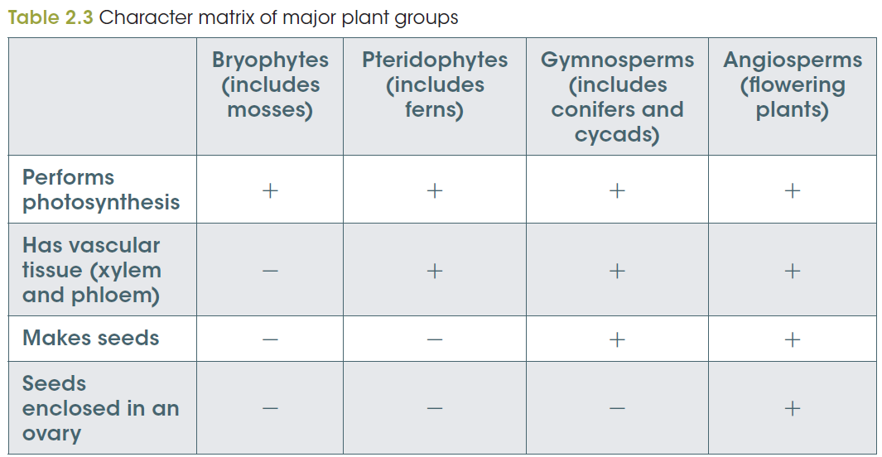
Classification reflects evolutionary relationships
Constructing a cladogram
Step 1 Tabulate character matrix - characteristics to be used.
Notes:
In the character matrix used to build this cladogram (Table 2.3) a + symbol is used to indicate when a characteristic is present and a – symbol when it is absent.

Slide 16
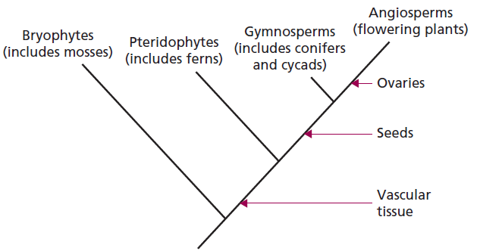
Classification reflects evolutionary relationships
Constructing a cladogram
Step 2
Arrange groups in different ways until the simplest cladogram is found. The arrows indicate when each characteristic evolved.
Notes:
In the character matrix used to build this cladogram (Table 2.3) a + symbol is used to indicate when a characteristic is present and a – symbol when it is absent.
Each taxonomic group contains all of the organisms descended from the same common ancestor.
When looking at a cladogram, a group contains all of the organisms on a branch. When this occurs, that group is called a clade (or can be referred to as monophyletic).

Slide 17
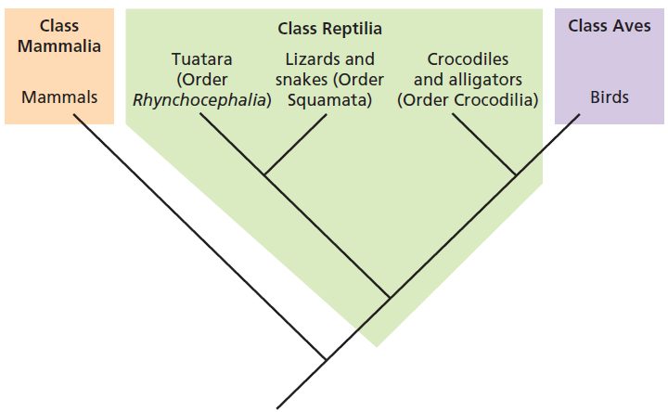
Classification reflects evolutionary relationships
Constructing a cladogram
Notes:
Three classes of animals are shown in the cladogram.
You can see that both class Aves and Class Mammalia are clades because they contain all of the animals on that branch.
Class Reptilia, however, is not a clade. This is because it does not contain birds which also descended from a reptilian ancestor.
Class Reptilia can be called a paraphyletic group.
This arrangement has occurred because birds and reptiles were classified into separate classes before their evolutionary relationships were known. More recently, it has been determined that birds evolved from dinosaurs and as such, share a recent common ancestor with crocodiles and alligators. Some scientists have suggested that these taxonomic groups need to be reclassified to ensure that all are clades.

Slide 18
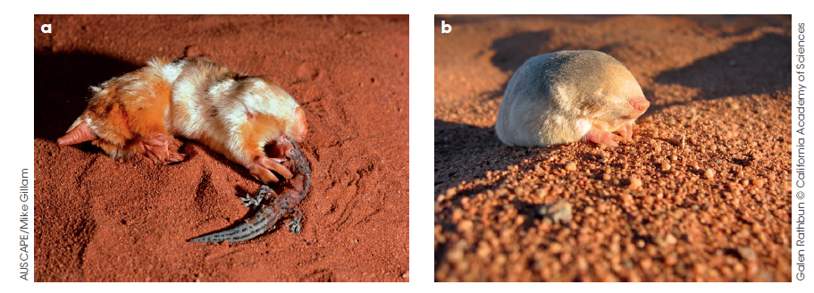
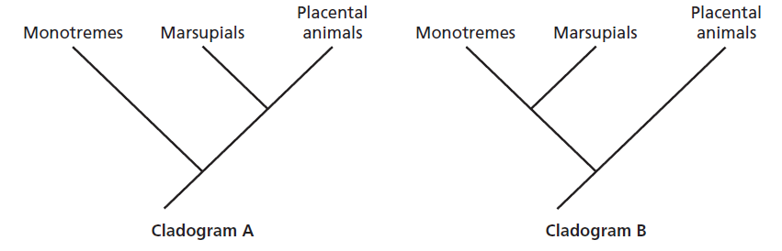
Classification reflects evolutionary relationships
Limitations of cladistics
Should marsupial moles and golden moles be grouped together?
Marsupial moles and
b) golden moles are superficially similar, but have evolved their characteristics independently.
Notes:
One of the limitations of cladistics occurs when unrelated organisms have evolved similar characteristics independently. This can occur with organisms that inhabit similar niches in different parts of the world, as in the case of marsupial moles and African golden moles.
Figure 2.19 includes two different cladograms showing the evolution of monotremes, marsupials and placental mammals. Cladogram A is currently regarded as correct.
Should marsupial moles and golden moles be grouped together? Not if we think about their method of reproduction. Like other marsupials, marsupial moles give birth to live young at an extremely young age. These young then develop in a specialised pouch until they are mature enough to survive outside. Golden moles are placental mammals meaning that their young develop inside the mother until the time of birth. Golden moles cannot be grouped with marsupials even though, externally, marsupial moles and golden moles are almost identical to look at.
It is important to understand that cladograms are theories about the way that organisms are related. Like all scientific theories, they can be confirmed or challenged when more evidence is available.

Slide 19
Classification reflects evolutionary relationships
The impact of new technologies on taxonomy
DNA technology provides new and highly detailed information about evolutionary relationships.
Supports previous classification or reclassifies of organisms
Provides clarity as to when certain groups evolved
Allows classification down to many more levels than the traditionally recognised taxa; i.e. prefixes super- (above) and sub- (below) - additional ranks (e.g. subphylum) and some newer taxa (e.g. tribe)
Notes:
Additionally, as some changes in DNA occur at a predictable rate, DNA technology has allowed scientists to understand when certain groups evolved.
Possible to classify organisms down to many more levels than the traditionally recognised taxa.
The prefixes super- (above) and sub- (below) can be added to existing taxa to create additional ranks (e.g. subphylum) and some newer taxa (e.g. tribe) are also recognised.
Some scientists have argued that because of this complexity, the taxa are no longer relevant and have suggested replacing it with a system called the PhyloCode. The PhyloCode assigns a name to a clade along with a definition of the members, but does not assign a rank to these names. For example, Mammalia could be defined as the clade originating with the most recent common ancestor of humans and platypuses.

